Slide 1
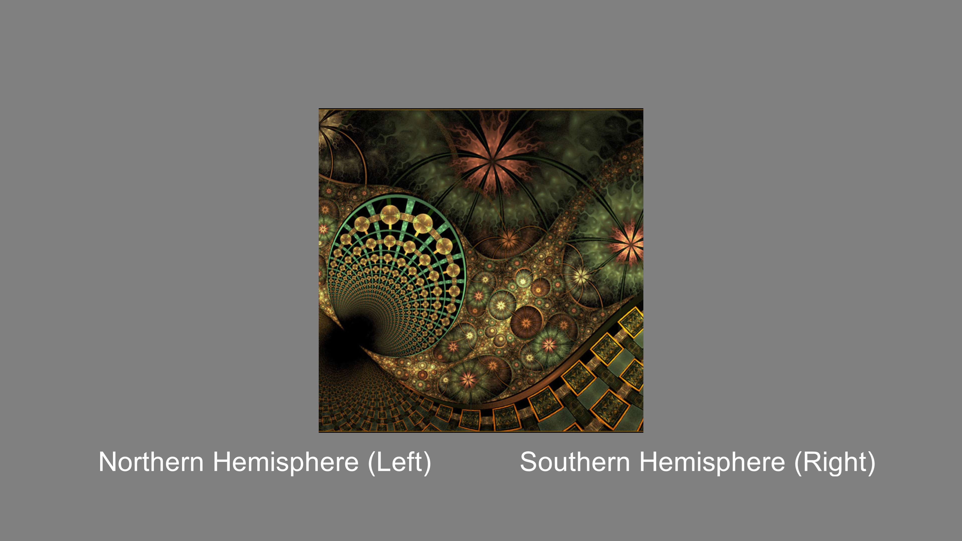
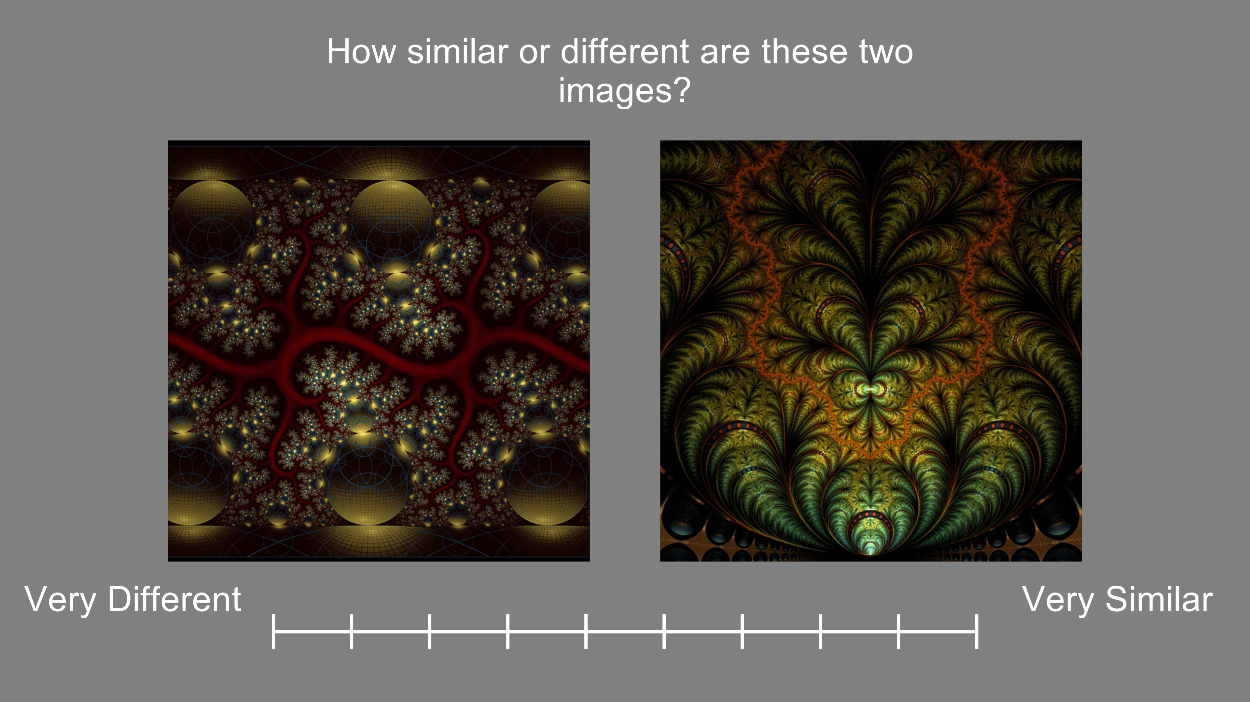
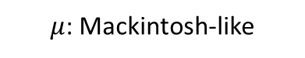

A. Tasks
Experiment 1a and 1b
Experiment 2
Response = Left or Right (Categories North or South)
Next trial until response…
Response = Different/Similar Slider
Next trial until response….
B. Network Architecture
S←
→N
Legend:
A, … H = Input cues
MM_{i} = Multi-modal unit ith
= Full connectivity = neurocomputational unit
= connection
Output
$μ$: Mackintosh-like
MM₁
MM₂
MM₃
MM₄
Hidden
$ρ$ Pearce-Hall-like
A
B
C
D
E
F
G
H
Input

Slide 2

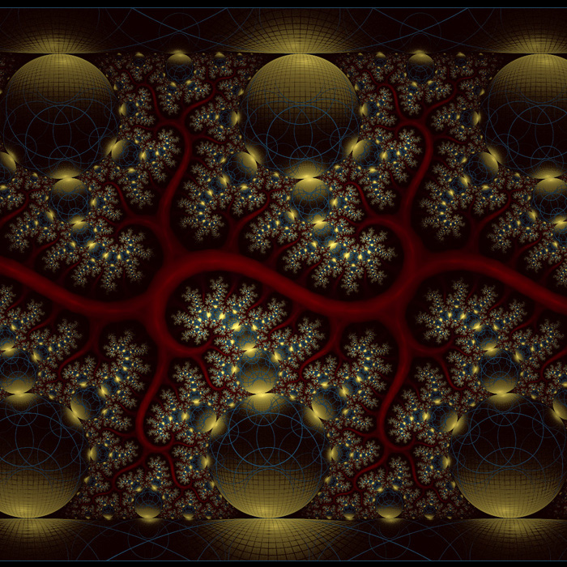
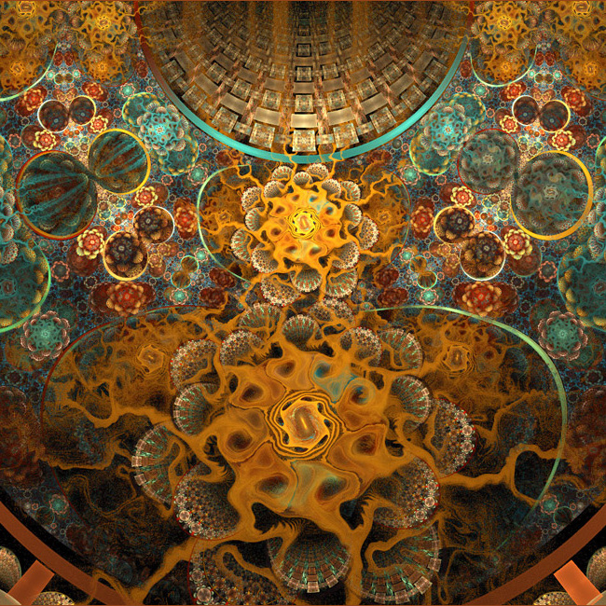

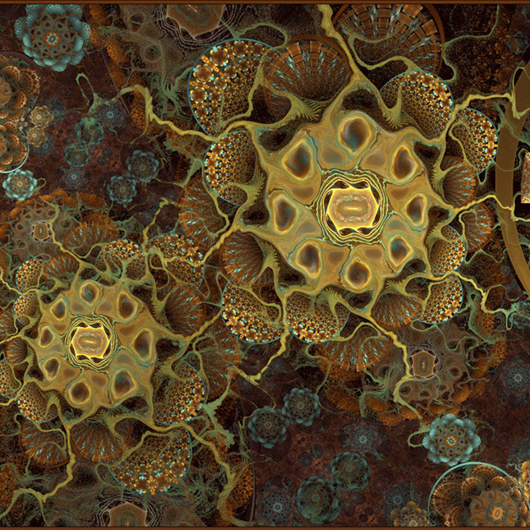






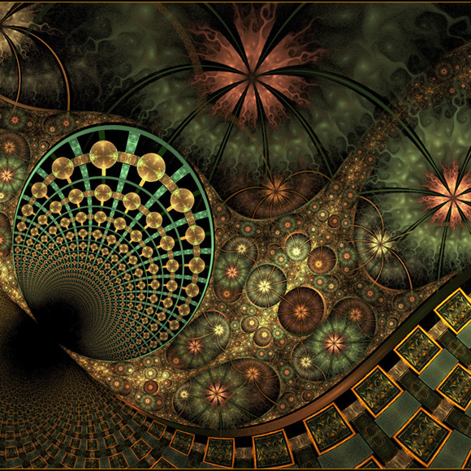
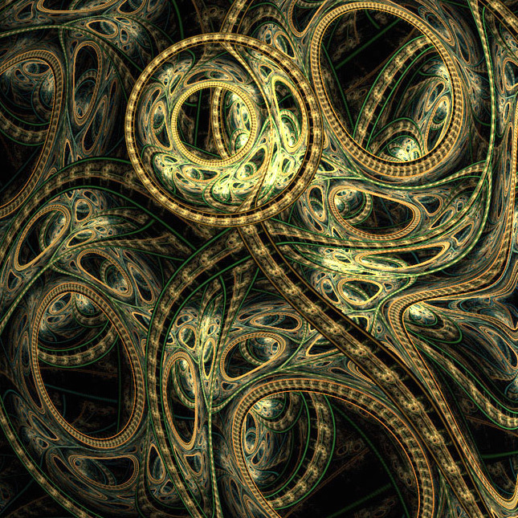



A. Tasks
Experiment 1a and 1b
Experiment 2
Response = Left or Right (Categories North or South)
Next trial until response…
Response = Different/Similar Slider
Next trial until response….
B. Fractal Sets
Set 1
Set 2

